Slide 1
Bitcoin as a Future Currency
Md Tanzim Hossain

Slide 2
What is Bitcoin?
Introduction to Bitcoin:
Bitcoin is digital money created in 2009.
It's stored in a digital format, like a virtual wallet.
Peer-to-Peer Transactions:
People can send and receive Bitcoin directly.
No need for banks or middlemen.
Blockchain Technology:
Transactions are recorded on a secure public ledger.
Everyone can see them, making it transparent.

Slide 3
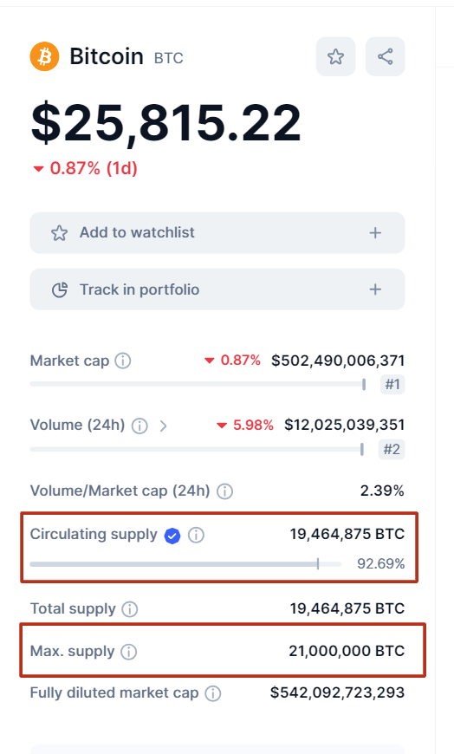
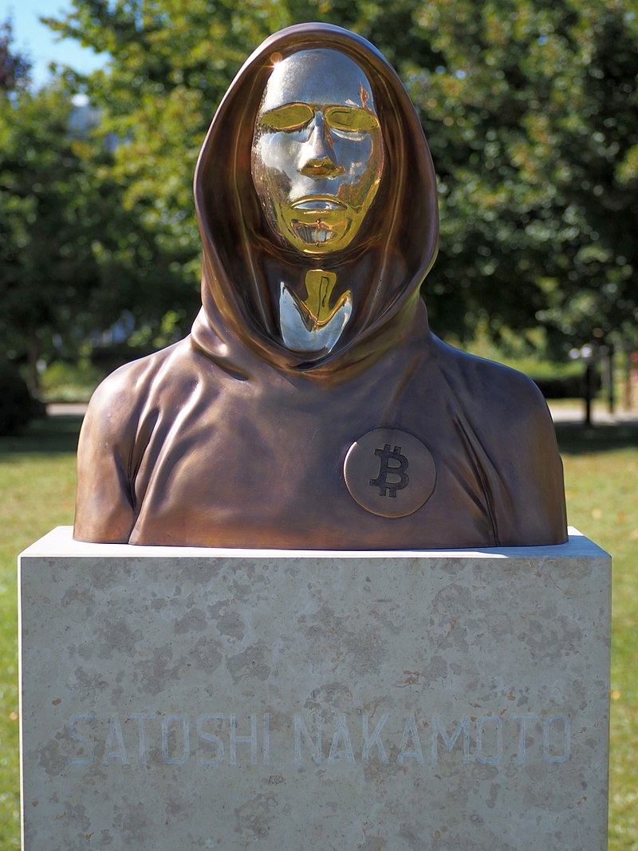
Why Bitcoin was Created?
Decentralization
Bitcoin was created in 2009 by an unknown person or group named Satoshi Nakamoto.
It aimed to challenge the centralization of traditional banking systems.
Ownership and Control
With Bitcoin, you can control your finances independently.
You control your digital wallet.
Limited Supply
Bitcoin's supply is fixed at 21 million coins.
This limits the amount of Bitcoin that can be mined, as opposed to regular money.

Slide 4
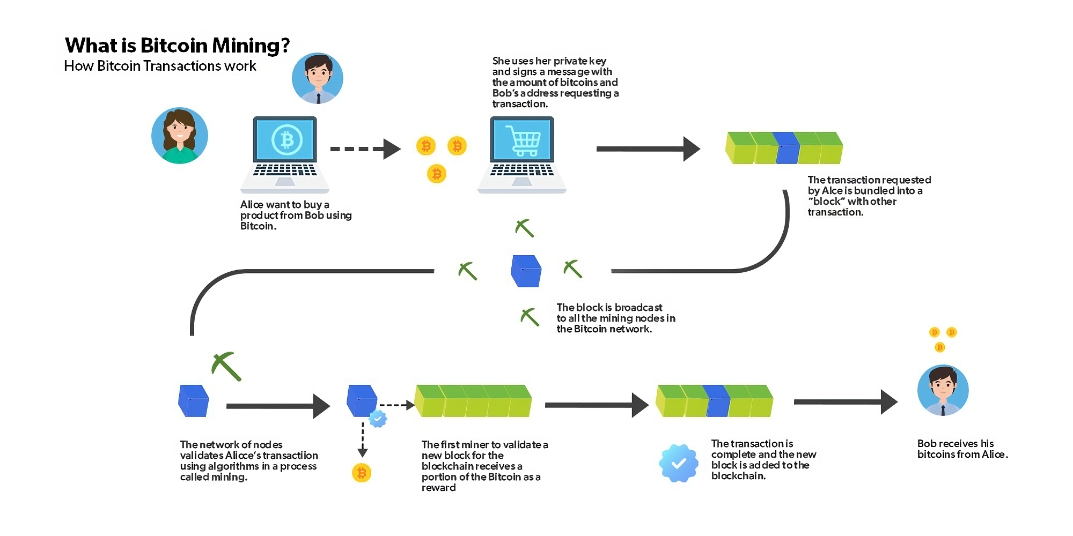

Slide 5
Advantages of Bitcoin
Fast Global Transactions
Lower Transaction Fees
Financial Freedom
Security and Privacy
Inflation Resistance
Borderless Nature

Slide 6
Future Potential of Bitcoin
More Stores Accepting
Big companies (like Microsoft, Tesla, PayPal) start using Bitcoin as money.
It's like using your phone to pay for things.
Changing Money Thinking
Bitcoin isn't regular money; it's digital and new.
It's like a cool idea changing how we see money.
Helping More People
Bitcoin can help people who don't have banks.
You can use it even if you don't have a bank account.
New Kind of Investment
Bitcoin isn't only money, but also something to invest in.
People think it might grow in value, like a treasure.

Slide 7
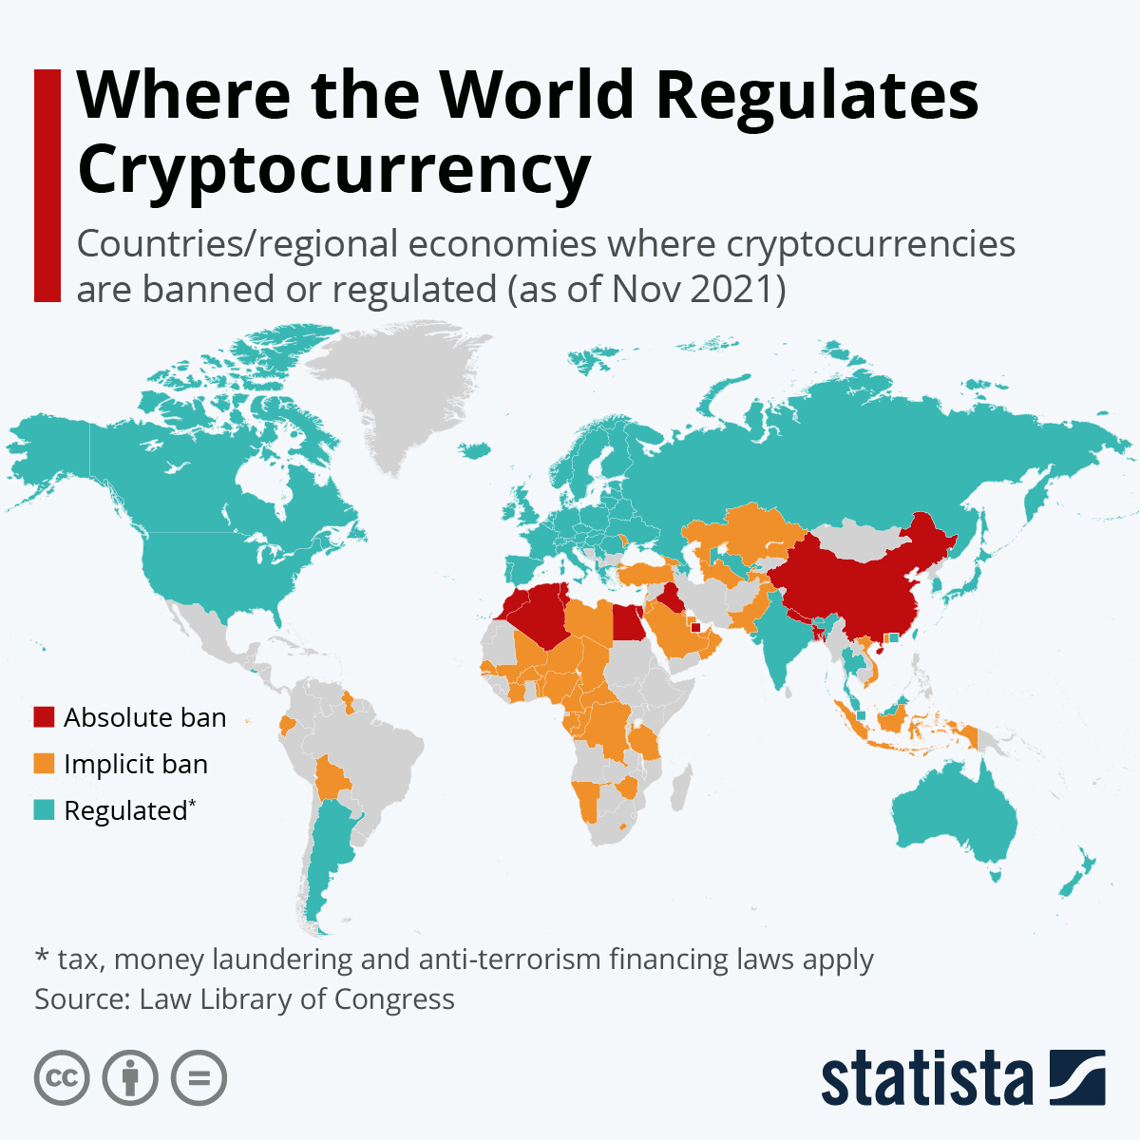
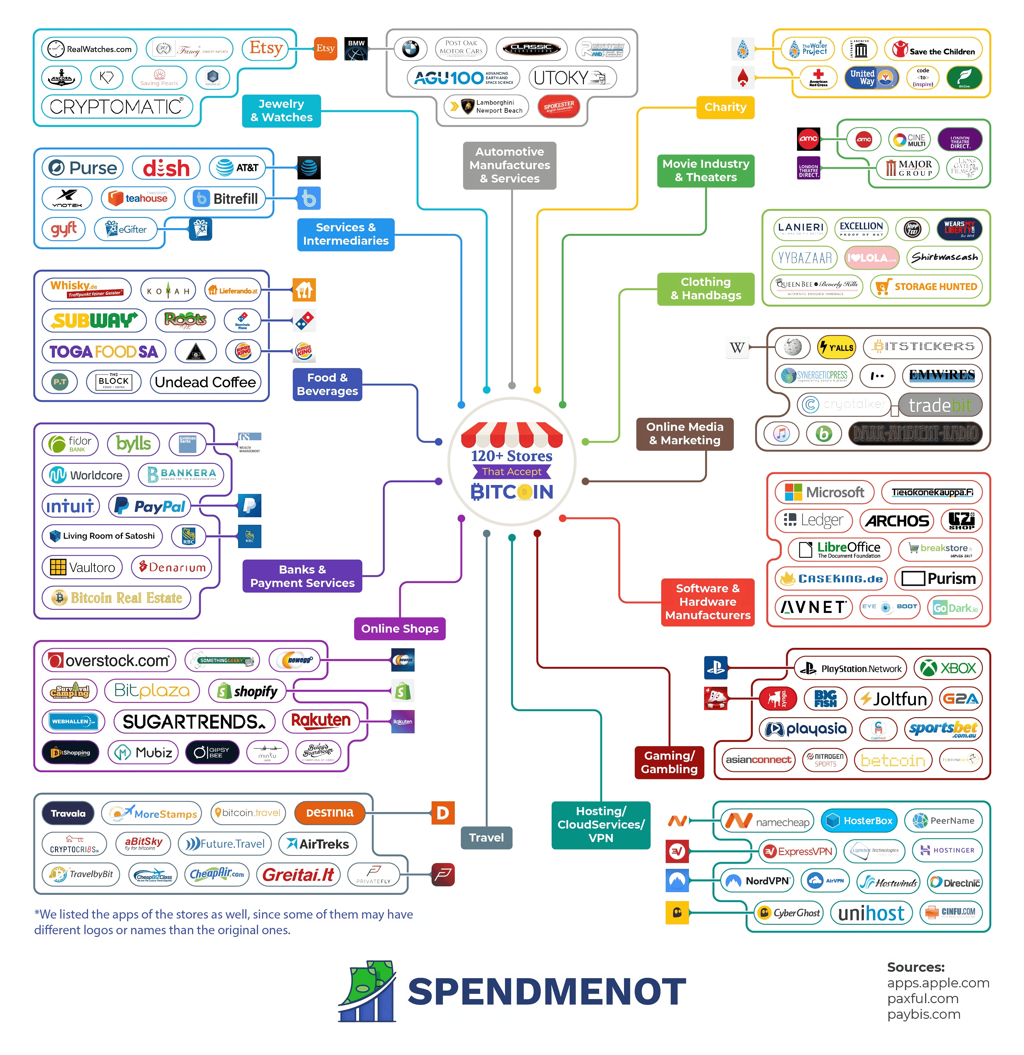

Slide 8
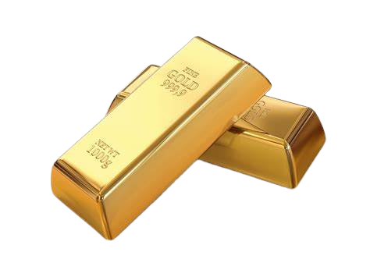
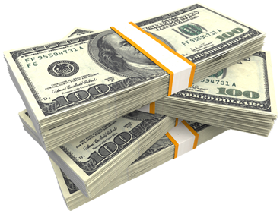
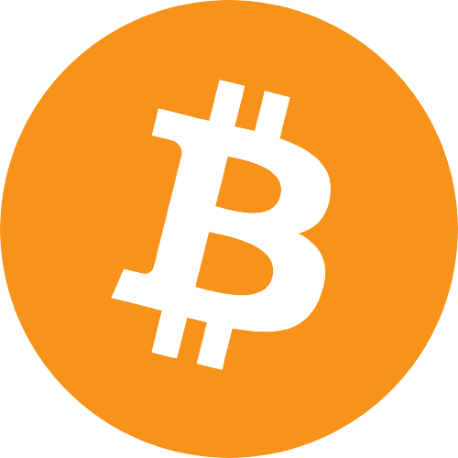
Conclusion
Bitcoin is like a super cool experiment with money and technology. It might stay, but regular money won't go away. We've seen how it gives us new ideas about money rules, banks, and different money types. Let's keep exploring and enjoy the ride!
Thank You
1800s
1900s
Today

